Slide 1
UNIX – System Administration

Slide 2

CONTENTS
Remote Connection and File Transfer
The superuser root
For Internal Use Only

Slide 3
Remote Connection and File Transfer

Slide 4
Remote Connection and File Transfer
Connecting to remote machines
Network routing utilities
Remote file transfer
Other Internet-related utilities
Email utilities

Slide 5
Connecting to remote machines
telnet provides an insecure mechanism for logging into remote machines because all data (including your username and password) is passed in unencrypted format over the network.
Useful utility, however, because, by specifying different port numbers, telnet can be used to connect to other services offered by remote machines besides remote login (e.g. web pages, email, etc.) and reveal the mechanisms behind how those services are offered
syntax:
telnet machinename

Slide 6
Connecting to remote machines
rlogin and rsh are insecure facilities for logging into remote machines and for executing commands on remote machines respectively. Along with telnet, they have been superseded by ssh.
syntax:
rlogin hostname

Slide 7
Connecting to remote machines
ssh (secure shell) is a secure alternative for remote login and also for executing commands in a remote machine. Provides secure encrypted communications between two untrusted hosts over an insecure network.
syntax:
ssh machinename
ssh clients are also available for Windows machines (e.g. there is a good ssh client called putty).
Notes:
Ssh

Slide 8
Remote Connection and File Transfer
Connecting to remote machines
Network routing utilities
Remote file transfer
Other Internet-related utilities
Email utilities

Slide 9
Network routing utilities
The ping utility is useful for checking round-trip response time between machines.
syntax:
ping machinename
e.g.
$ ping www.doc.ic.ac.uk
measures the reponse time delay between the current machine and the web server at the Department of Computing at Imperial College. ping is also useful to check whether a machine is still "alive" in some sense.

Slide 10
Network routing utilities
traceroute shows the full path taken to reach a remote machine, including the delay to each machine along the route. This is particularly useful in tracking down the location of network problems
syntax:
traceroute machinename

Slide 11
Remote Connection and File Transfer
Connecting to remote machines
Network routing utilities
Remote file transfer
Other Internet-related utilities
Email utilities

Slide 12
Remote file transfer
ftp (file transfer protocol) is an insecure way of transferring files between computers.
When you connect to a machine via ftp, you will be asked for your username and password or you can often use the user "ftp" or "anonymous".
Once logged in via FTP, you can list files (dir), receive files (get and mget) and send files (put and mput).
Notes:
ftp [-46pinegvd] [host [port]]
*Sudo apt-get update
Sudo apt-get install vsftpd
/etc/vsftpd.conf
Edit:
Anonymous_enable=YES
Write_enable=YES
anon_upload_enable=YES
Sudo restart vsftpd
ftp <ip of server>
Username: anonymous
Password: <enter>

Slide 13
Remote file transfer
scp (secure copy) is a secure way of transferring files between computers. It works just like the UNIX cp command except that the arguments can specify a user and machine as well as files.
syntax:
scp sourcefiles destination
example:
$ scp will@rose.doc.ic.ac.uk:~/hello.txt

Slide 14
Remote Connection and File Transfer
Connecting to remote machines
Network routing utilities
Remote file transfer
Other Internet-related utilities
Email utilities

Slide 15

Other Internet-related utilities
netscape is a fully-fledged graphical web browser (like Internet Explorer).

Slide 16
Other Internet-related utilities
lynx provides a way to browse the web on a text-only terminal.
wget provides a way to retrieve files from the web (using the HTTP protocol). wget is non-interactive, which means it can run in the background, while the user is not logged in (unlike most web browsers).
The content retrieved by wget is stored as raw HTML text (which can be viewed later using a web browser).

Slide 17
Remote Connection and File Transfer
Connecting to remote machines
Network routing utilities
Remote file transfer
Other Internet-related utilities
Email utilities

Slide 18
Email utilities
mail is the standard UNIX utility for sending and receiving email.
Example:
$ mail
Mail version 8.1 6/6/93. Type ? for help.
"/var/spool/mail/will": 2 messages 2 new
1 jack@sprat.com Mon Dec 11 10:37 "Beanstalks"
2 bill@whitehouse.gov Mon Dec 11 11:00 "Re: Monica"
&

Slide 19
Email utilities
Here are some of the important commands (type ? for a full list)
? help
q quit, saving changes to mailbox
x quit, restoring mailbox to its original state
t messagelist displays messages
+/- show next/previous message
d messagelist deletes messages
u messagelist undelete messages
m address send a new email
r messagelist reply to sender and other receipients
R messagelist reply only to sender

Slide 20
Email utilities
You can also use mail to send email directly from the command line.
You can also use mail to send email directly from the command line:
example:
$ mail -s "Hi" wjk@doc.ic.ac.uk < message.txt
$
emails the contents of the (ASCII) file message.txt to the recipient wjk@doc.ic.ac.uk with the subject "Hi"

Slide 21
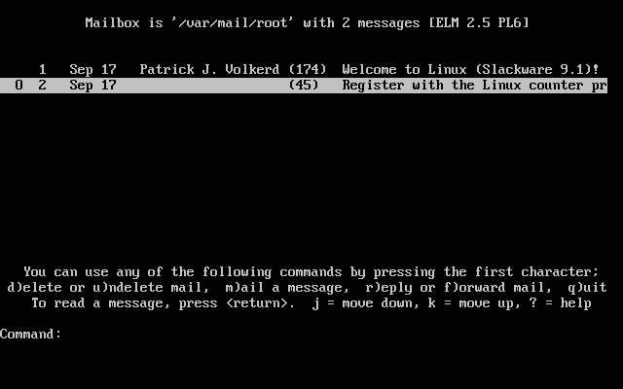
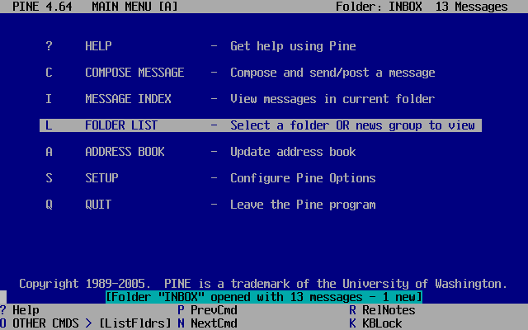
Email utilities
You can also use mail to send email directly from the command line.
mutt, elm and pine are more friendly (but non-standard) email interfaces that you will probably prefer to use instead of mail. All have good in-built help facilities.

Slide 22
Email utilities
You can also use mail to send email directly from the command line.
Email is actually sent using an Email Transfer Agent, which uses a protocol called SMTP (Simple Mail Transfer Protocol). The two most popular Email Transfer Agents are sendmail and exim.
You can see how these agents work by using telnet to connect to port 25 of any mail server

Slide 23
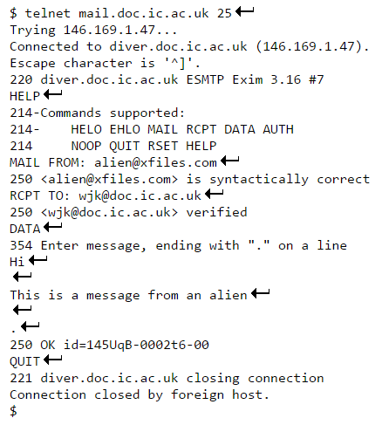
Email utilities
You can also use mail to send email directly from the command line.
Example:

Slide 24
The superuser Root

Slide 25
The superuser Root
The superuser is a privileged user who has unrestricted access to all commands and files on a system regardless of their permissions. The superuser’s login is usually root.
A better way to become root is to use the su (switch user) utility.
If you don't specify the name of the user you wish to become, the system will assume you want to become root.

Slide 26
The superuser root
Syntax:
$ su -
Password: xxxxxxxx
#
Note that the root account often displays a different prompt (usually a #). To return to your old self, simply type "exit" at the shell prompt.

Slide 27
The superuser Root
Shutdown and System Startup
Adding Users
Controlling User Groups
Reconfiguring and Recompiling the Linux Kernel
Cron Jobs
Keeping Essential System Processes Alive
Redirecting Input and Output

Slide 28
Shutdown and System Startup
/sbin/shutdown allows a UNIX system to shut down gracefully and securely.
/sbin/shutdown –r now (shut down now and reboot)
/sbin/shutdown –h +5 (shut down in 5 minutes & halt)
/sbin/shutdown –k 17:00 (fake a shutdown at 5pm)
If you have to shut a system down extremely urgently or for some reason cannot use shutdown, it is at least a good idea to first run the command:
# sync

Slide 29
Shutdown and System Startup
At system startup, the operating system performs various low-level tasks, such as initializing the memory system, loading up device drivers to communicate with hardware devices, mounting file systems and creating the init process (the parent of all processes).
init's primary responsibility is to start up the system services as specified in /etc/inittab.

Slide 30
Shutdown and System Startup
If a mounted filesystem is not "clean" (e.g. the machine was turned off without shutting down properly), a system utility fsck is automatically run to repair it.
Automatic running can only fix certain errors, however, and you may have to run it manually:
# fsck filesys

Slide 31
The superuser Root
Shutdown and System Startup
Adding Users
Controlling User Groups
Reconfiguring and Recompiling the Linux Kernel
Cron Jobs
Keeping Essential System Processes Alive
Redirecting Input and Output

Slide 32
Adding Users
useradd (in /usr/sbin):
useradd is a utility for adding new users to a UNIX system. It adds new user information to the /etc/passwd file and creates a new home directory for the user. When you add a new user, you should also set their password (using the -p option on useradd, or using the passwd utility):
# useradd bob
# passwd bob

Slide 33
The superuser root
Shutdown and System Startup
Adding Users
Controlling User Groups
Reconfiguring and Recompiling the Linux Kernel
Cron Jobs
Keeping Essential System Processes Alive
Redirecting Input and Output

Slide 34
Controlling User Groups
groupadd (in /usr/sbin):
groupadd creates a new user group and adds the new information to /etc/group:
# groupadd groupname
Notes:
To add users to group, use
Useradd

Slide 35
Controlling User Groups
usermod (in /usr/sbin):
Every user belongs to a primary group and possibly also to a set of supplementary groups. To modify the group permissions of an existing user, use
# usermod -g initialgroup username -G othergroups
where othergroups is a list of supplementary group names separated by commas (with no intervening whitespace).

Slide 36
Controlling User Groups
groups
You can find out which groups a user belongs to by typing:
# groups username

Slide 37
The superuser Root
Shutdown and System Startup
Adding Users
Controlling User Groups
Reconfiguring and Recompiling the Linux Kernel
Cron Jobs
Keeping Essential System Processes Alive
Redirecting Input and Output

Slide 38
Reconfiguring and Recompiling the Linux Kernel
Linux has a modular, customizable kernel with several switchable options. It may happen that some new hardware is added to a Linux machine which requires you to recompile the kernel so that it includes device driver support for the new hardware. To do this, you will need to rebuild the Linux kernel from scratch as follows:
Look in /usr/src/linux for the kernel source code.

Slide 39
Reconfiguring and Recompiling the Linux Kernel
If it isn't there (or if there is just a message saying that only kernel binaries have been installed), get hold of a copy of the latest kernel source code from http://www.kernel.org and untar it into /usr/src/linux.
Change directory to /usr/src/linux.
To configure the kernel type either
# make config (simple text mode configuration)
# make menuconfig (menu-driven text configuration)
# make xconfig (graphical configuration for X)

Slide 40
Reconfiguring and Recompiling the Linux Kernel
You will be asked to select which modules you wish to include. For each module, you can chose to include it in the kernel code (y), incorporate it as an optional module that will be loaded if needed (m) or to exclude it from the kernel code (n). To find out which optional modules have actually been loaded you can run lsmod when the system reboots.

Slide 41
Reconfiguring and Recompiling the Linux Kernel
Now type:
# make dep (to build source code dependencies)
# make clean (to delete all stale object files)
# make bzImage (to build the new kernel)
# make modules (to build the new optional modules)
# make modules_install (to install the modules)
The file /usr/src/linux/arch/i386/boot/bzImage now contains your new kernel image. It remains only to install it.

Slide 42
Reconfiguring and Recompiling the Linux Kernel
Change directory to /usr/src/linux/arch/i386/boot. In the same directory should be a script called install.sh which will copy your kernel image into /boot/vmlinuz:
# install.sh version bzImage /boot/System.map /boot
where version is the kernel version number.

Slide 43
Reconfiguring and Recompiling the Linux Kernel
Finally, you may need to update the /etc/lilo.conf file so that lilo (the Linux boot loader) includes an entry for your new kernel. Then run
# lilo
to update the changes. When you reboot your machine, you should be able to select your new kernel image from the lilo boot loader.

Slide 44
The superuser Root
Shutdown and System Startup
Adding Users
Controlling User Groups
Reconfiguring and Recompiling the Linux Kernel
Cron Jobs
Keeping Essential System Processes Alive
Redirecting Input and Output

Slide 45
Cron Jobs
crond is a daemon that executes commands that need to be run regularly according to some schedule. The schedule and corresponding commands are stored in the file /etc/crontab.
Each entry in the /etc/crontab file entry contains six fields separated by spaces or tabs in the following form:
minute hour day_of_month month weekday command

Slide 46
Cron Jobs
These fields accept the following values:
minute 0 through 59
hour 0 through 23
day_of_month 1 through 31
month 1 through 12
weekday 0 (Sun) through 6 (Sat)
command a shell command

Slide 47
Cron Jobs
You must specify a value for each field. Except for the command field, these fields can contain the following:
A number in the specified range, e.g. to run a command in May, specify 5 in the month field.
Two numbers separated by a dash to indicate an inclusive range, e.g. to run a cron job on Tuesday through Friday, place 2-5 in the weekday field.
A list of numbers separated by commas, e.g. to run a command on the first and last day of January, you would specify 1,31 in the day_of_month field.
* (asterisk), meaning all allowed values, e.g. to run a job every hour, specify an asterisk in the hour field.

Slide 48
Cron Jobs
You can also specify some execution environment options at the top of the /etc/crontab file:
SHELL=/bin/bash
PATH=/sbin:/bin:/usr/sbin:/usr/bin
MAILTO=root
To run the calendar command at 6:30am. every Mon, Wed, and Fri, a suitable /etc/crontab entry would be:
30 6 * * 1,3,5 /usr/bin/calendar
The output of the command will be mailed to the user specified in the MAILTO environment option.
You don't need to restart the cron daemon crond after changing /etc/crontab - it automatically detects changes.

Slide 49
The superuser Root
Shutdown and System Startup
Adding Users
Controlling User Groups
Reconfiguring and Recompiling the Linux Kernel
Cron Jobs
Keeping Essential System Processes Alive
Redirecting Input and Output

Slide 50
Keeping Essential System Processes Alive
It is important that daemons related to mission critical services are immediately respawned if they fail for some reason. You can do this by adding your own entries to the /etc/inittab file. For example:
rs:2345:respawn:/home/sms/server/RingToneServer
Here rs is a 2 character code identifying the service, and 2345 are the runlevels (to find about runlevels, type man runlevel) for which the process should be created. The init process will create the RingToneServer process at system startup, and respawn it should it die for any reason.

Slide 51
The superuser Root
Shutdown and System Startup
Adding Users
Controlling User Groups
Reconfiguring and Recompiling the Linux Kernel
Cron Jobs
Keeping Essential System Processes Alive
Redirecting Input and Output

Slide 52
Redirecting Input and Output
To redirect standard output to a file instead of the screen, we use the > operator:
$ echo hello
hello
$ echo hello > output
$ cat output
hello

Slide 53
Redirecting Input and Output
In this case, the contents of the file output will be destroyed if the file already exists. If instead we want to append the output of the echo command to the file, we can use the >> operator:
$ echo bye >> output
$ cat output
hello
bye

Slide 54
Redirecting Input and Output
To capture standard error, prefix the > operator with a 2 (in UNIX the file numbers 0, 1 and 2 are assigned to standard input, standard output and standard error respectively), e.g.:
$ cat nonexistent 2>errors
$ cat errors
cat: nonexistent: No such file or directory
$

Slide 55
Redirecting Input and Output
You can redirect standard error and standard output to two different files:
$ find . -print 1>errors 2>files
or to the same file:
$ find . -print 1>output 2>output
or:
$ find . -print >& output

Slide 56
Redirecting Input and Output
Standard input can also be redirected using the < operator, so that input is read from a file instead of the keyboard:
$ cat < output
hello
bye
You can combine input redirection with output redirection, but be careful not to use the same filename in both places. For example:
$ cat < output > output
will destroy the contents of the file output. This is because the first thing the shell does when it sees the > operator is to create an empty file ready for the output.

Slide 57
Redirecting Input and Output
One last point to note is that we can pass standard output to system utilities that require filenames as "-":
$ cat package.tar.gz | gzip -d | tar tvf -
Here the output of the gzip -d command is used as the input file to the tar command.

